Slide 1
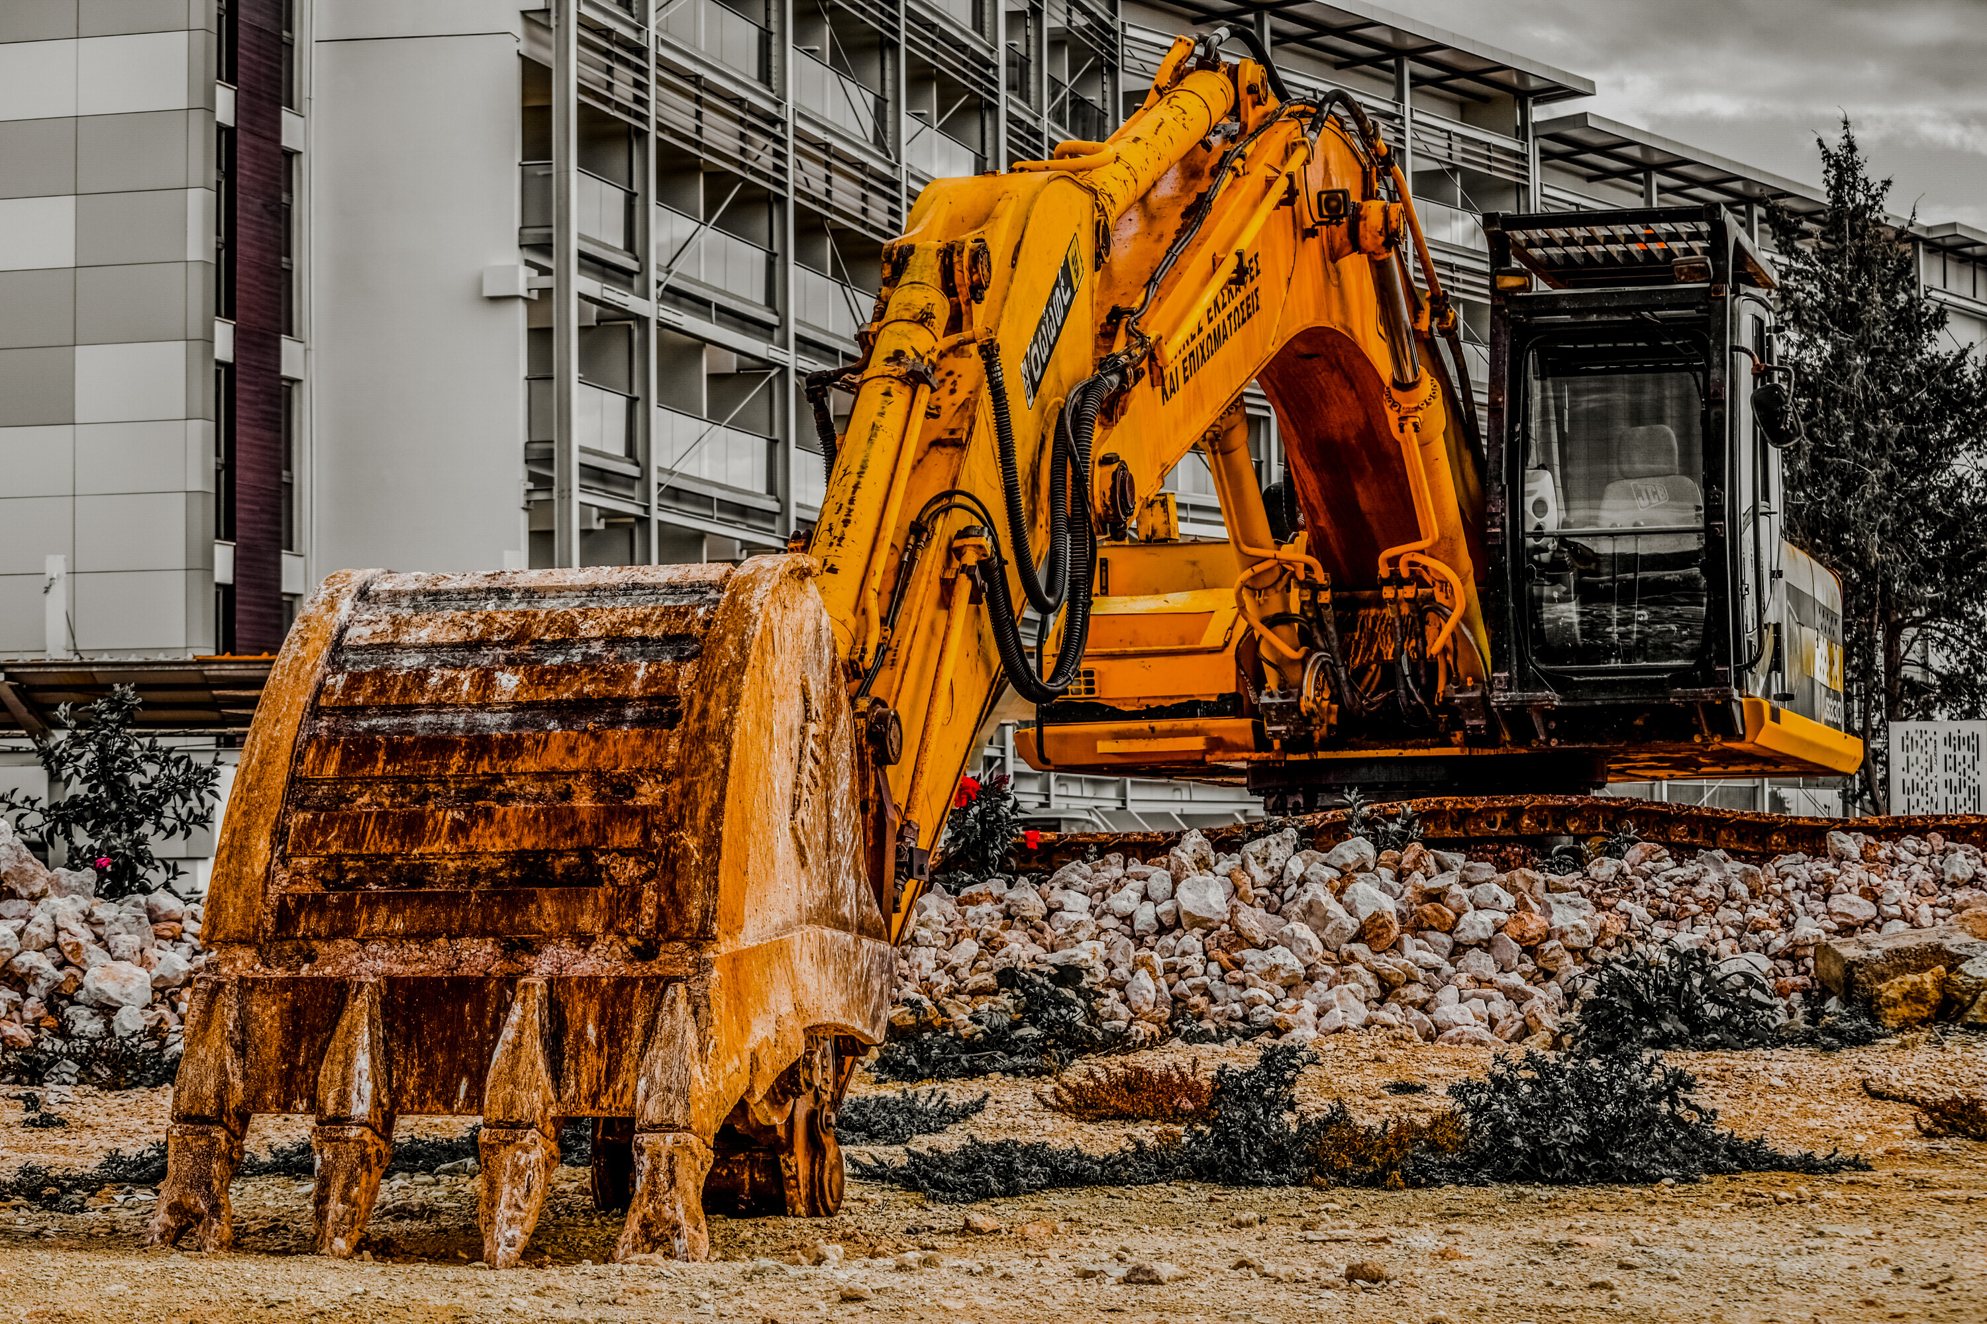



MetaConstruct
@ Copyright, RayZen, 2023.

Slide 2

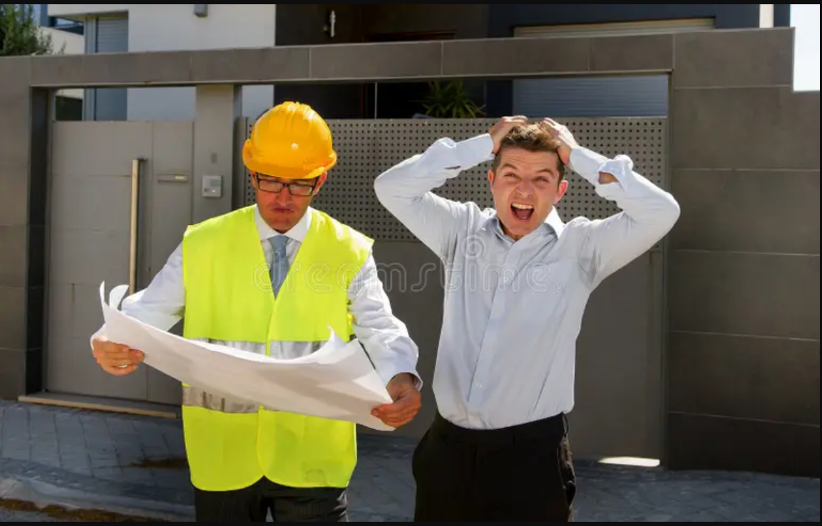
The Problem Statement
When a customer commissions a company to build a house, and the company completes the construction, the customer later raises concerns about the house's design and specifications.

Slide 3
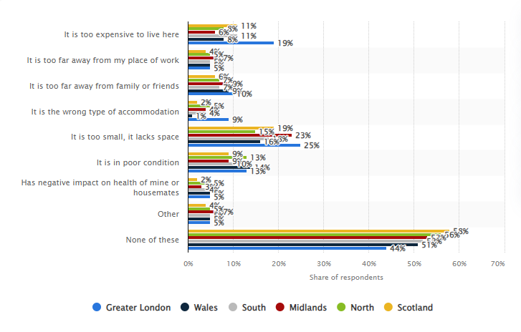
Survey

Slide 4

MetaConstruct Visualization
The Idea - Solution
Integration of Metaverse into Construction

Slide 5

Key Features
Customer Engagement
Customer’s Initial Interaction with the
construction agency.

Slide 6

Virtual Building Maps
A Digital Gateway to explore various
Building designs.

Slide 7
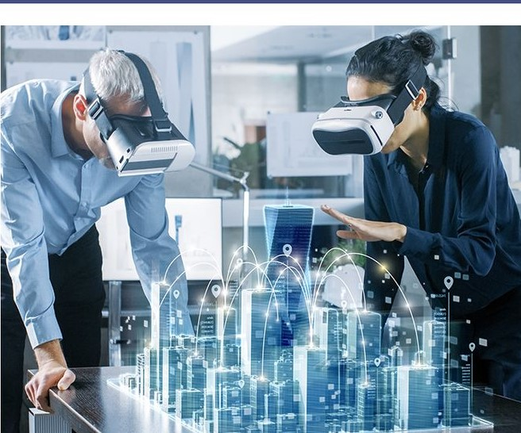
Selection & Customization
Enables Customers to Actively Select
Building designs and personalized layouts.

Slide 8

Virtual Building
Visualization
An Immersive experience where customers
can virtually walk through and experience
their designs.

Slide 9
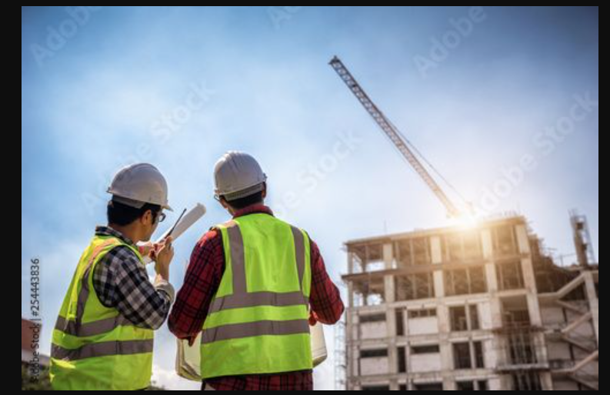
Confirmation &
Real Construction
The transition from virtual to reality
that is Confirming selections and initiating
Real Constructions.

Slide 10
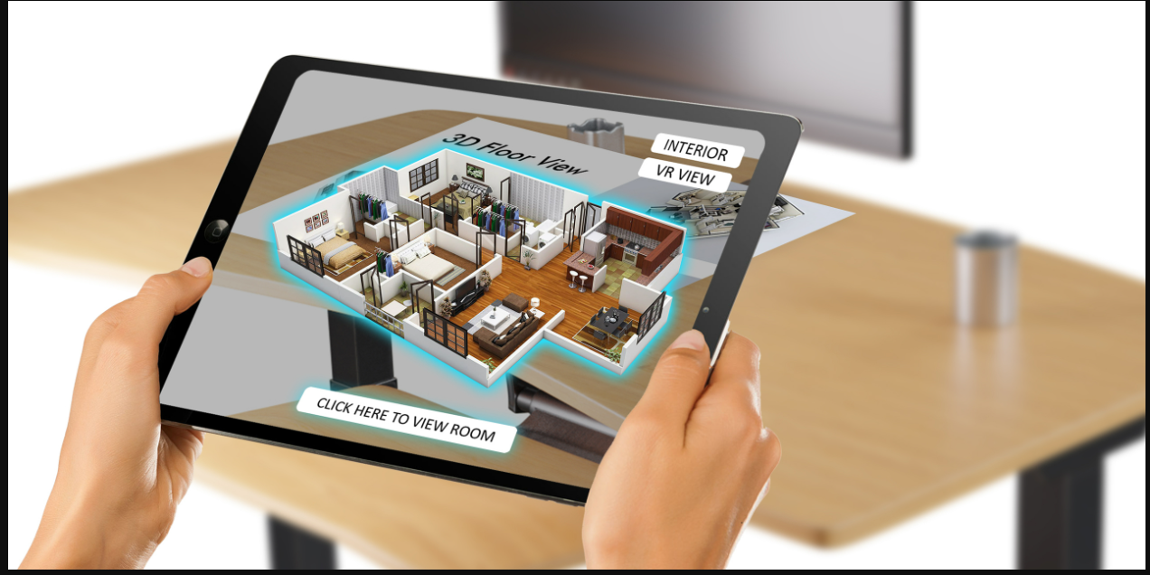
Extended Version
Augmented Reality for Virtual Objects
in Real Spaces

Slide 11

Benefits
Enhanced Customer Satisfaction
Competitive Advantage
Reduced Revisions
Marketing and Branding
Inform Decision-Making

Slide 12
THANK YOU
@ Copyright, RayZen, 2023.

